Slide 1


Lecture 12
Produced by Dr. Worldwide
Welcome to the 305
~
~

Slide 2

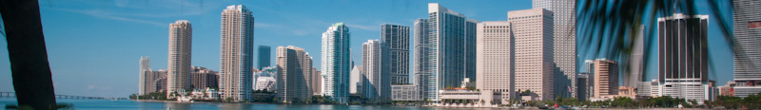
Shortest Route Problem
Dijkstra’s algorithm for identifying the shortest route
Step 1: Select the node with the shortest route from the origin
Step 2: Create a permanent set that includes the origin and the node chosen in the 1st step
Step 3: Identify all nodes that are adjacent to the nodes in the permanent set
Step 4: Select the node with the shortest route from the group of nodes adjacent to the nodes in the permanent set. Add the chosen node to the permanent set
Step 5: Repeat the 3rd and 4th steps until all nodes are in the permanent set

Slide 3

Shortest Route Problem
We want to reformulate the problem as a linear program
The origin in the shortest route problem can be thought of as a single supply node
The other nodes can be thought of as demand nodes
Source has supply equal to the number of nodes in the graph minus one (itself)
Each demand node requires a single unit
Distance between nodes corresponds to transportation cost of that edge
To reduce the number of variables, we assume units only flow in the direction of a higher node number
Ignore $x_{ij} if i≥j$

Slide 4
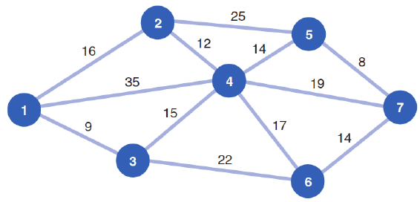
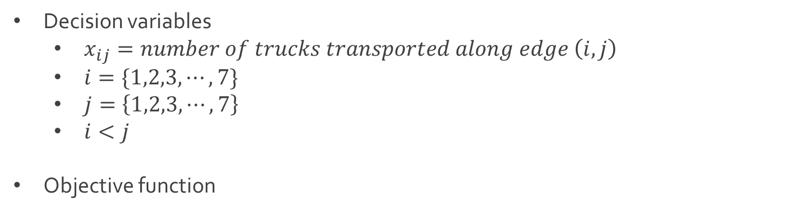
Ex: Shortest Shipping Route
Decision variables
$x_{ij}=number of trucks transported along edge \left(i,j\right)$
$i=\{1,2,3,⋯, 7\}$
$j=\left\{1,2,3,⋯,7\right\}$
$i<j$
Objective function
$$Z=16x_{12}+35x_{14}+9x_{13}+12x_{24}$$
$+15x_{34}+25x_{25}+14x_{45}+17x_{46}$
$+22x_{36}+8x_{57}+19x_{47}+14x_{67}$

Slide 5
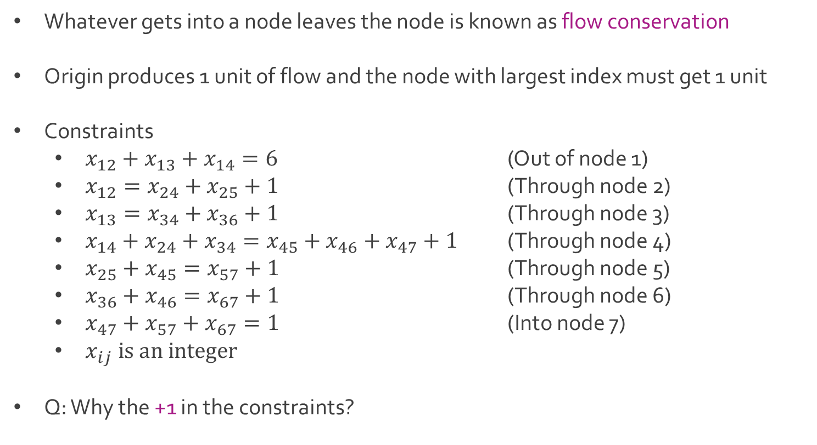
Ex: Shortest Shipping Route
Whatever gets into a node leaves the node is known as flow conservation
Origin produces 1 unit of flow and the node with largest index must get 1 unit
Constraints
$x_{12}+x_{13}+x_{14}=6$ (Out of node 1)
$x_{12}=x_{24}+x_{25}+1$ (Through node 2)
$x_{13}=x_{34}+x_{36}+1$ (Through node 3)
$x_{14}+x_{24}+x_{34}=x_{45}+x_{46}+x_{47}+1$ (Through node 4)
$x_{25}+x_{45}=x_{57}+1$ (Through node 5)
$x_{36}+x_{46}=x_{67}+1$ (Through node 6)
$x_{47}+x_{57}+x_{67}=1$ (Into node 7)
$x_{ij} is an integer$
Q: Why the +1 in the constraints?

Slide 6
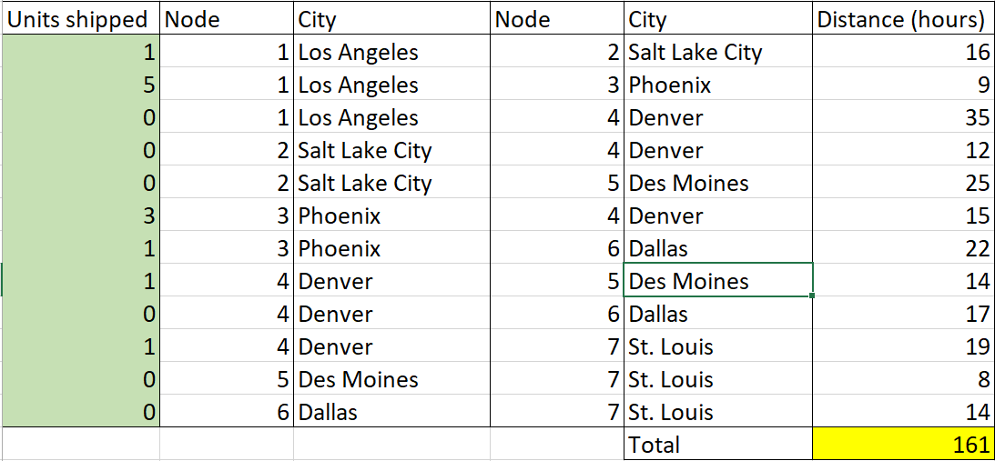
Ex: Shortest Shipping Route
Download ShortestRoute.xlsx from course website from link Sheet 1
Look at tab titled One-to-All

Slide 7
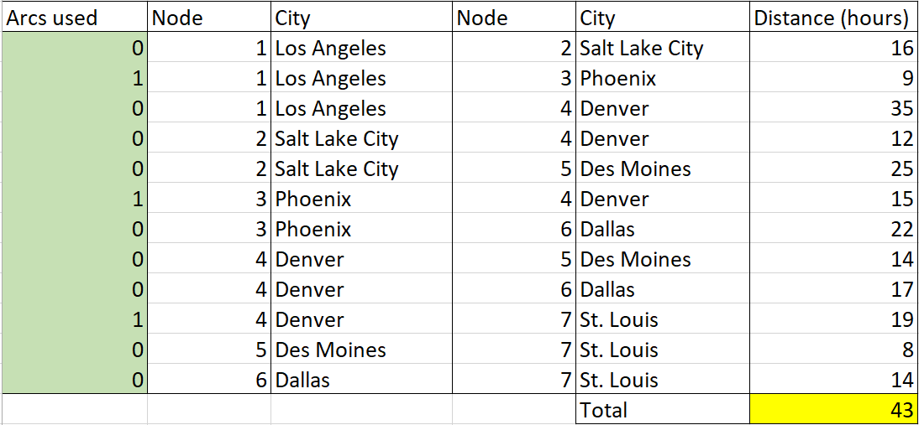
Ex: Shortest Shipping Route
Look at tab titled One-to-One
Q:What is the difference between One-to-All and One-to-One?

Slide 8
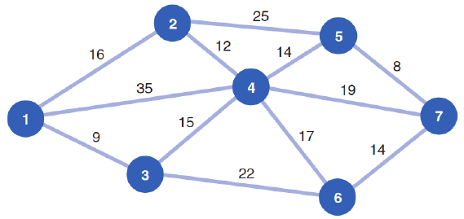
Shortest Route Problem
Assumed that we had supply at origin (node 1) to fulfill demand at all other nodes
Suppose we only wanted to get one unit from the origin to one destination node
We must modify the constraints to reflect a supply and demand of one

Slide 9
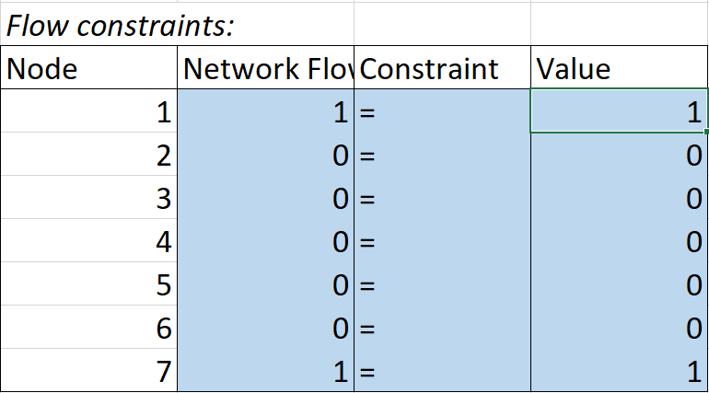
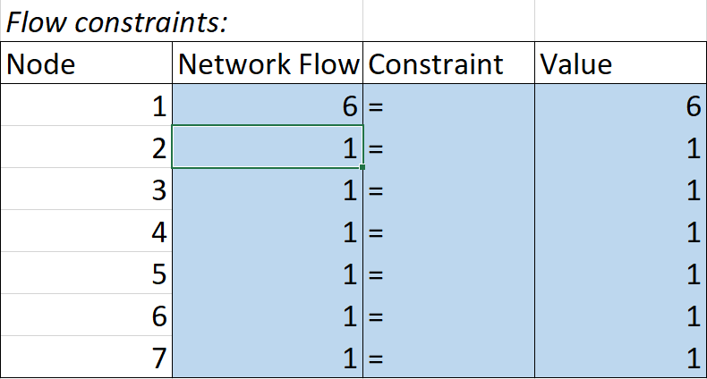

Ex: Shortest Shipping Route
Modification of constraints
One origin to many destinations
One origin to one destination
Difference Between In and Out
$$x_{12}−x_{24}−x_{25}$$

Slide 10
Shortest Route Problem
Assumed that edges had direction from West (node 1) to East (nodes 2-7)
Suppose direction doesn’t matter
We must consider both directions for each branch

Slide 11

Ex: Shortest Shipping Route
Decision variables for undirected network
$x_{ij}=number of trucks transported along edge \left(i,j\right)$
$i=\{1,2,3,⋯, 7\}$
$j=\left\{1,2,3,⋯,7\right\}$
$i<j$ or $i>j$
Objective function for undirected network
$$Z=16{(x}_{12}+x_{21})+3{5(x}_{14}+x_{41})+9{(x}_{13}+x_{31})+12(x_{24}+x_{42})$$
$+ 15{(x}_{34}+x_{43})+25\left(x_{25}+x_{52}\right)+14\left(x_{45}+x_{54}\right)+17{(x}_{46}+x_{64})$
$+ 22(x_{36}+x_{63})+8\left(x_{57}+x_{75}\right)+19(x_{47}+x_{74})+14\left(x_{67}+x_{76}\right)$

Slide 12
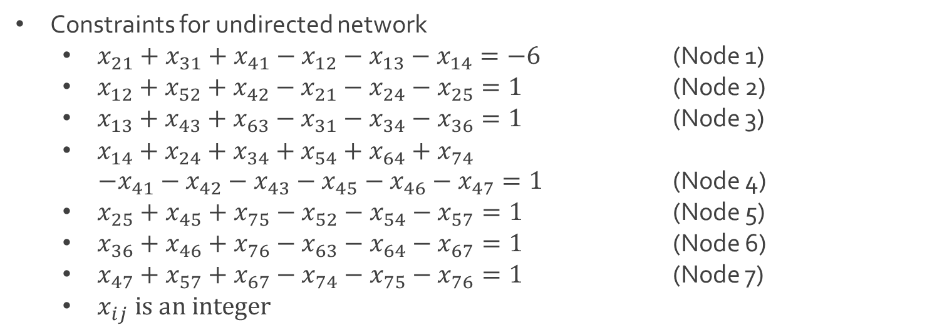
Ex: Shortest Shipping Route
Constraints for undirected network
$x_{21}+x_{31}+x_{41}−x_{12}−x_{13}−x_{14}=−6$ (Node 1)
$x_{12}+x_{52}+x_{42}−x_{21}−x_{24}−x_{25}=1$ (Node 2)
$x_{13}+x_{43}+x_{63}−x_{31}−x_{34}−x_{36}=1$ (Node 3)
$x_{14}+x_{24}+x_{34}+x_{54}+x_{64}+x_{74}$
$−x_{41}−x_{42}−x_{43}−x_{45}−x_{46}−x_{47}=1$ (Node 4)
$x_{25}+x_{45}+x_{75}−x_{52}−x_{54}−x_{57}=1$ (Node 5)
$x_{36}+x_{46}+x_{76}−x_{63}−x_{64}−x_{67}=1$ (Node 6)
$x_{47}+x_{57}+x_{67}−x_{74}−x_{75}−x_{76}=1$ (Node 7)
$x_{ij} is an integer$

Slide 13
Ex: Shortest Shipping Route
Download ShortestRoute-1.xlsx from course website from link Sheet 2
The tabs One-to-All-Directed and One-to-One-Directed contain previous results
Closely examine the tabs One-to-All-Undirected and One-to-One-Undirected
Q: What do you notice is the same between directed and undirected problems?
Q: What do you notice is different between directed and undirected problems?
Q: What is the purpose of the number 1,000 in the distance matrix?

Slide 14
Maximal Flow Problem
Sometimes the branches in a network have limitations on the capacity
Suppose we are trying to move some resource (e.g. water, gas, oil) through a network of pipelines
Pipelines are represented as edges in a graph (directed or undirected) and each has a finite capacity that determines how much can flow through them
Source node produces the resource and a destination node receives it
Q: What is the maximum amount of flow that can be moved through the network?

Slide 15
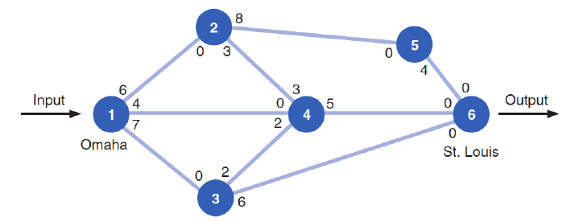
Ex: Railway System
Scott Tractor Company ships tractor parts from Omaha to St. Louis by railroad
A contract limits the number of railroad cars available on each branch
Graph of network showing the capacity (# of cars) leaving a node along an edge
Q: Is this undirected or directed?

Slide 16
Ex: Railway System
We begin by choosing an arbitrary path from the origin to the destination
A path can be defined by an ordering of nodes separated by hyphens
For example, choose the path 1-2-5-6
Q: What is the smallest capacity along this path?

Slide 17
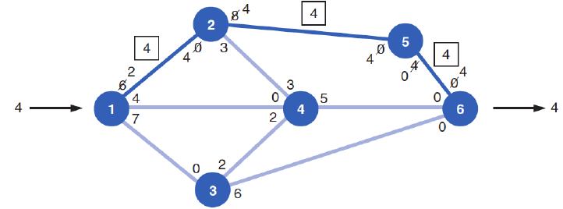
Ex: Railway System
The smallest capacity along the path is 4, corresponding to edge (5,6)
A directed edge can be defined as an ordered pair of two nodes
The capacity along the path 1-2-5-6 is 4
Update by decreasing the capacities along the edges (1,2), (2,5), and (5,6) by 4 and increasing the capacities along the edges (6,5), (5,2), and (2,1) by 4

Slide 18
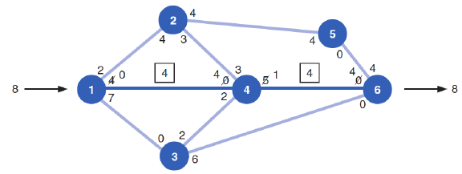

Ex: Railway System
Next, choose an arbitrary path from the updated graph
For example, choose 1-4-6
The smallest capacity is 4 because of (1,4); therefore, the capacity of 1-4-6 is 4
Update the capacities in the same way as before by decreasing in the direction 1-4-6 and increasing in the direction 6-4-1
Update maximum flow
$$4+4=8$$

Slide 19
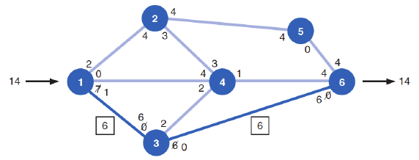

Ex: Railway System
Choose another arbitrary path from the updated graph like 1-3-6
The smallest capacity is 6 corresponding to edge (3,6)
Update the capacities according to the capacity of 1-3-6 which is 6
The maximum flow now is $4+4+6=14$

Slide 20
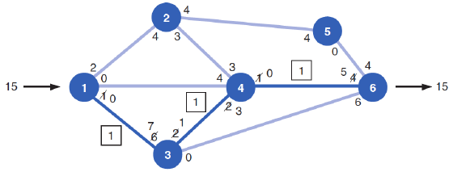
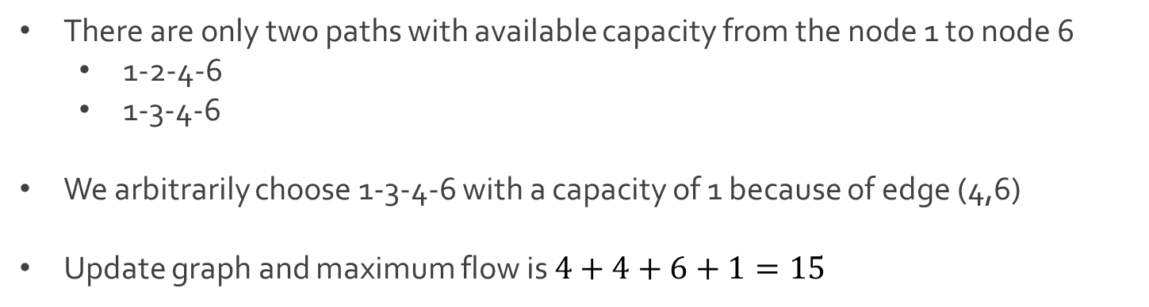
Ex: Railway System
There are only two paths with available capacity from the node 1 to node 6
1-2-4-6
1-3-4-6
We arbitrarily choose 1-3-4-6 with a capacity of 1 because of edge (4,6)
Update graph and maximum flow is $4+4+6+1=15$

Slide 21
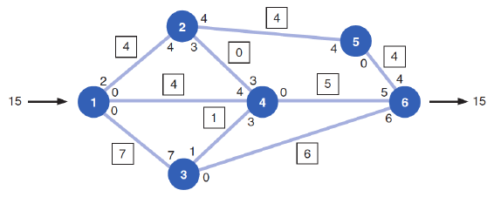
Ex: Railway System
No more paths to choose from in the updated graph
Algorithm terminates at this point
We say the maximum flow from node 1 to node 6 is 15

Slide 22
Shortest Route Problem
Ford-Fulkerson’s algorithm for identifying the maximal flow of a network
Step 1: Arbitrarily select any path in the network from the origin to destination
Step 2: Adjust the capacities at each node by subtracting the maximal flow for the path selected in the 1st step
Step 3: Add the maximal flow along the path in the opposite direction
Step 5: Repeat previous steps until there are no more paths with flow capacity

Slide 23




The End
Dale

